Slide 1
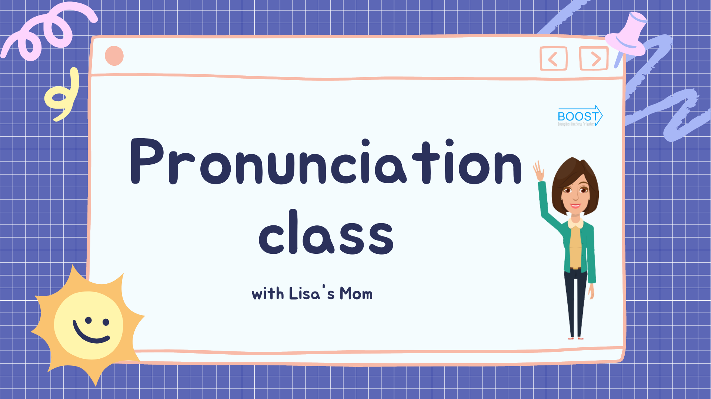

Pronunciation class with Lisa’s Mom
Notes:
Pronunciation class with?

Slide 2
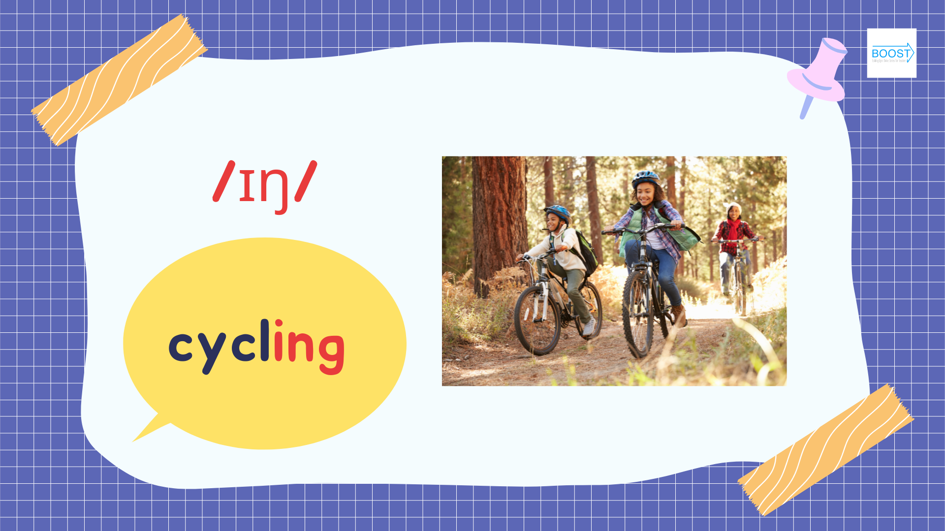

Notes:
/ɪŋ/
/ɪŋ/
Cycling
Cycling
They’re cycling
They’re cycling

Slide 3
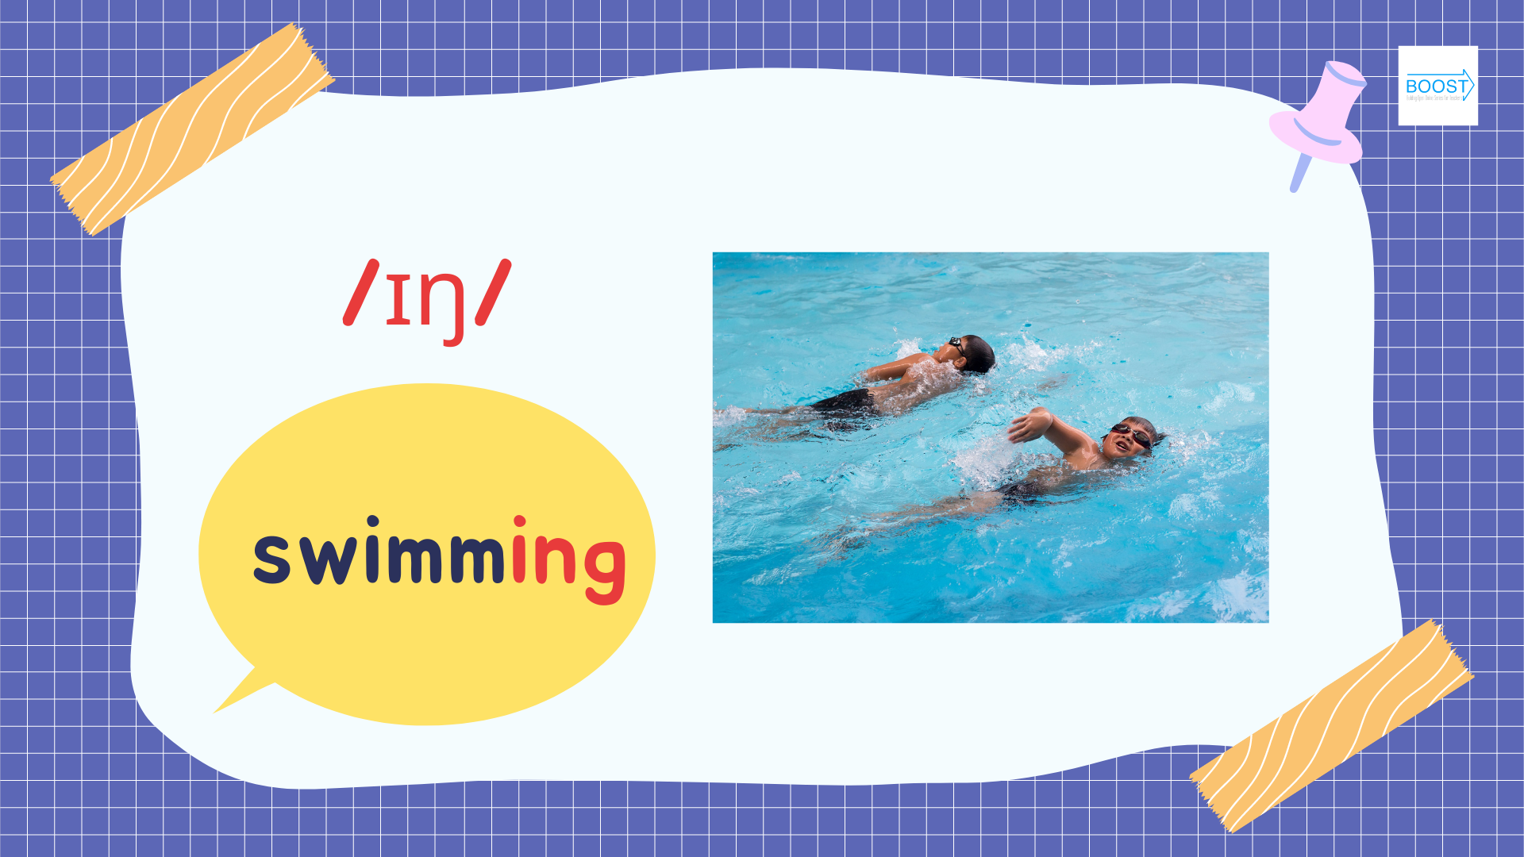
Notes:
/ɪŋ/
/ɪŋ/
Swimming
Swimming
She’s swimming
She’s swimming

Slide 4
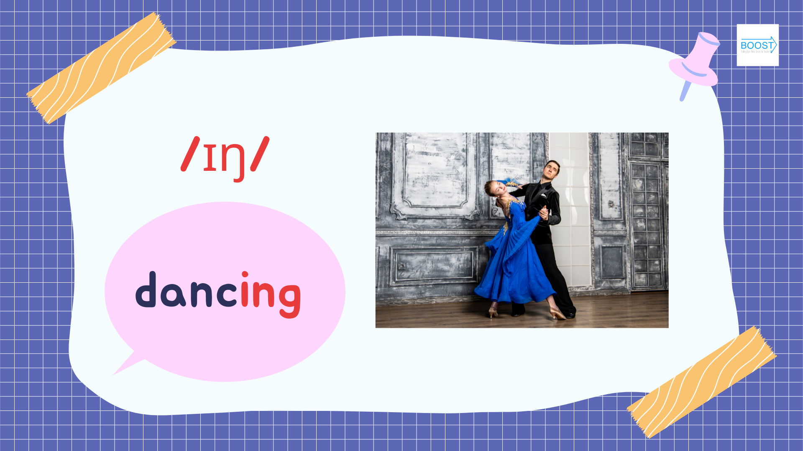
Notes:
/ɪŋ/
/ɪŋ/
Dancing
Dancing
They’re dancing
They’re dancing

Slide 5
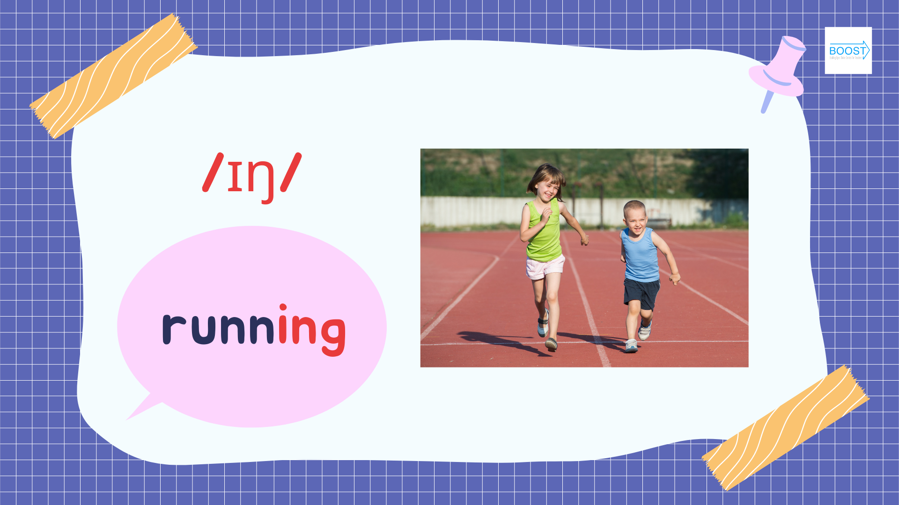
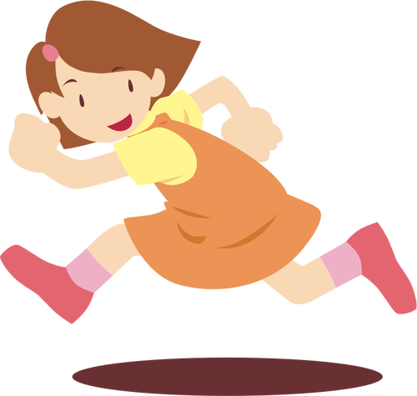
/ɪŋ/
running
Notes:
/ɪŋ/
/ɪŋ/
Running
Running
She’s running
She’s running

Slide 6
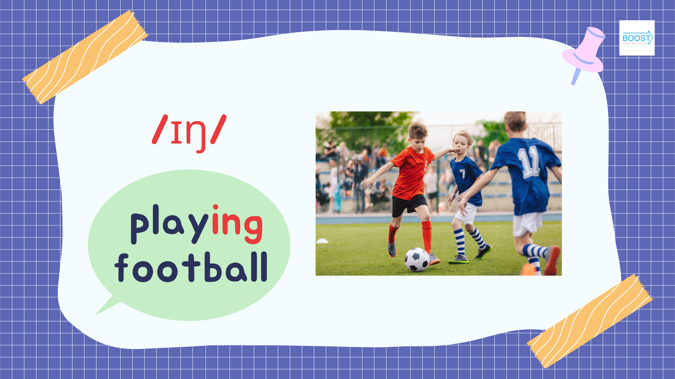
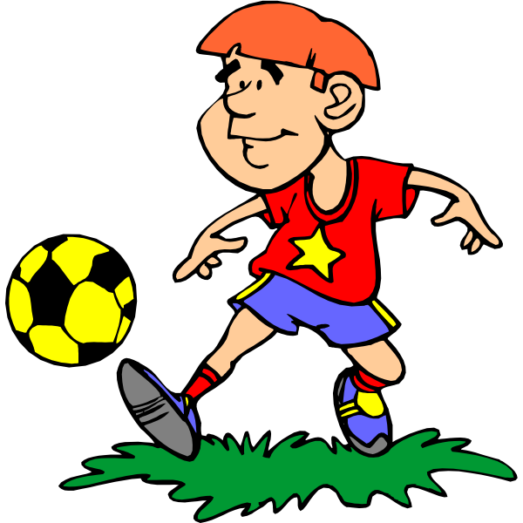

/ɪŋ/
playing football
Notes:
/ɪŋ/
/ɪŋ/
Playing football
Playing football
He’s playing football
He’s playing football

Slide 7
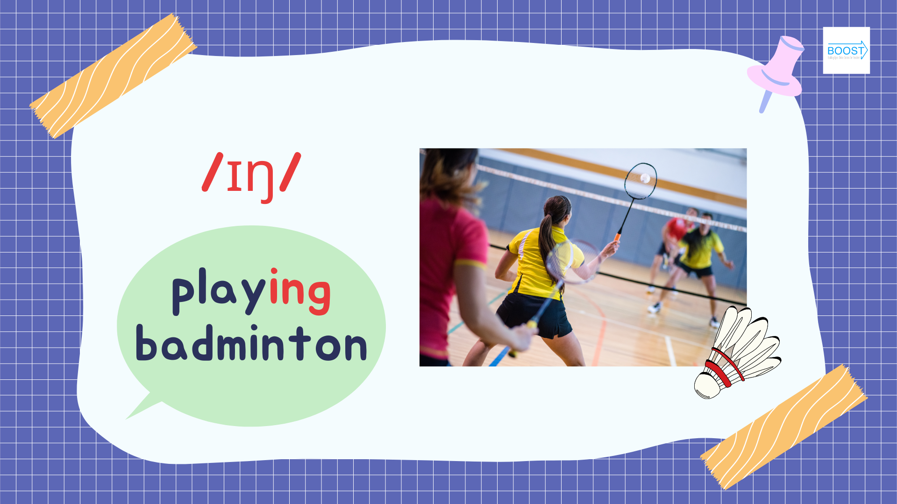
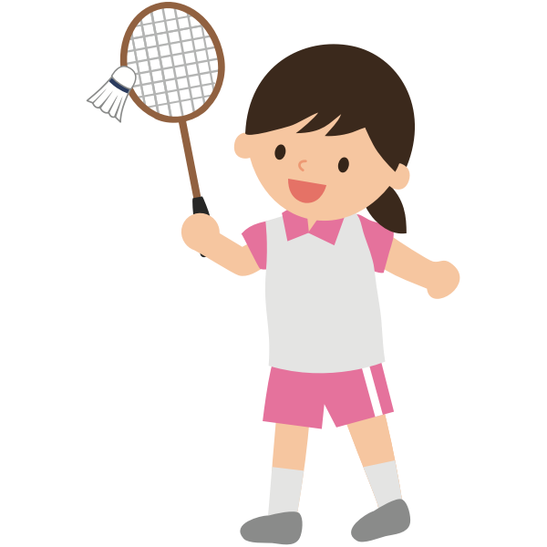
/ɪŋ/
playinging badminton
Notes:
/ɪŋ/
/ɪŋ/
Playing badminton
Playing badminton
She’s playing badminton
She’s playing badminton

Slide 8
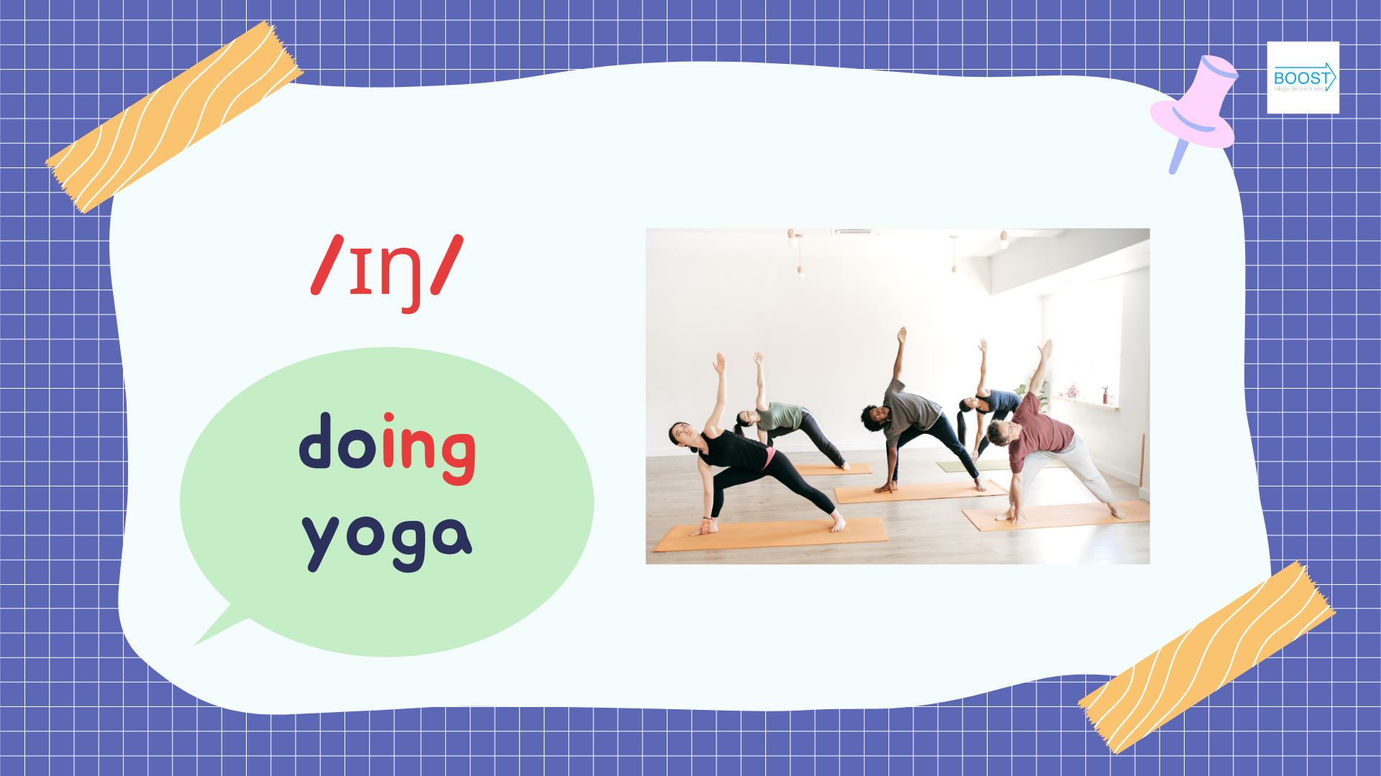
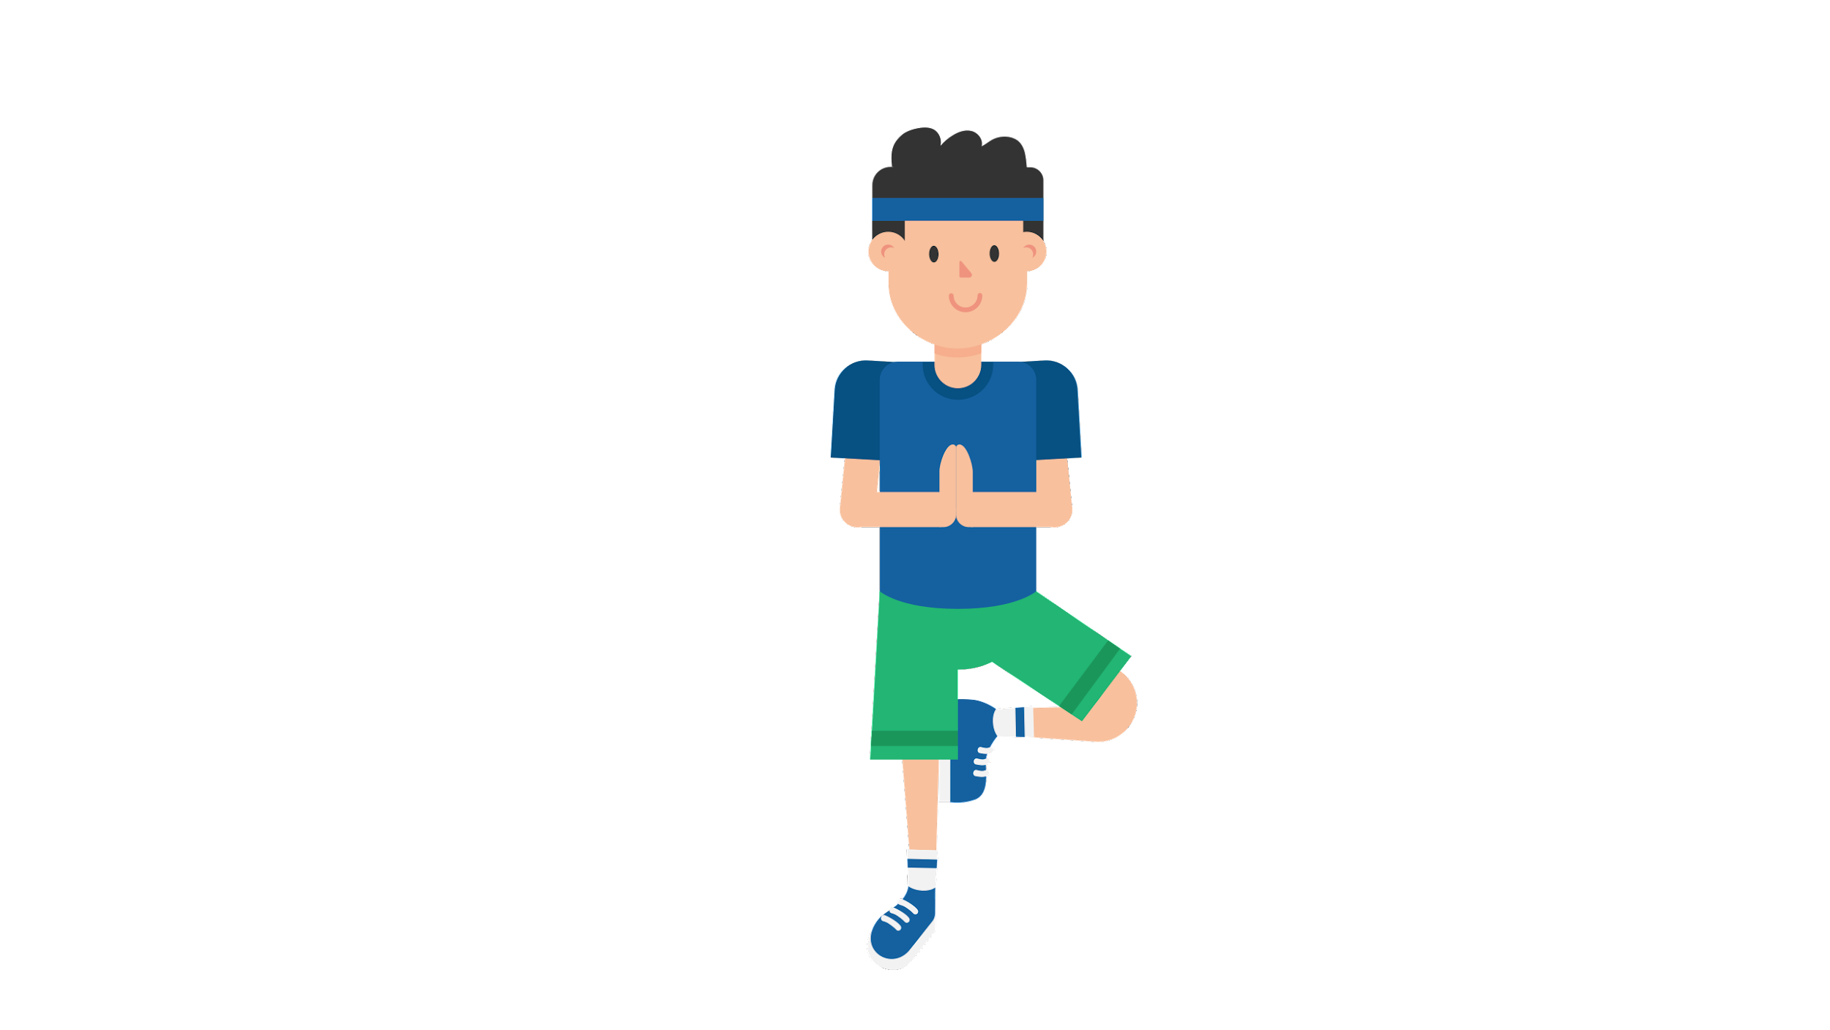
/ɪŋ/
doing yoga
Notes:
/ɪŋ/
/ɪŋ/
Doing yoga
Doing yoga
He’s doing yoga
He’s doing yoga

Slide 9
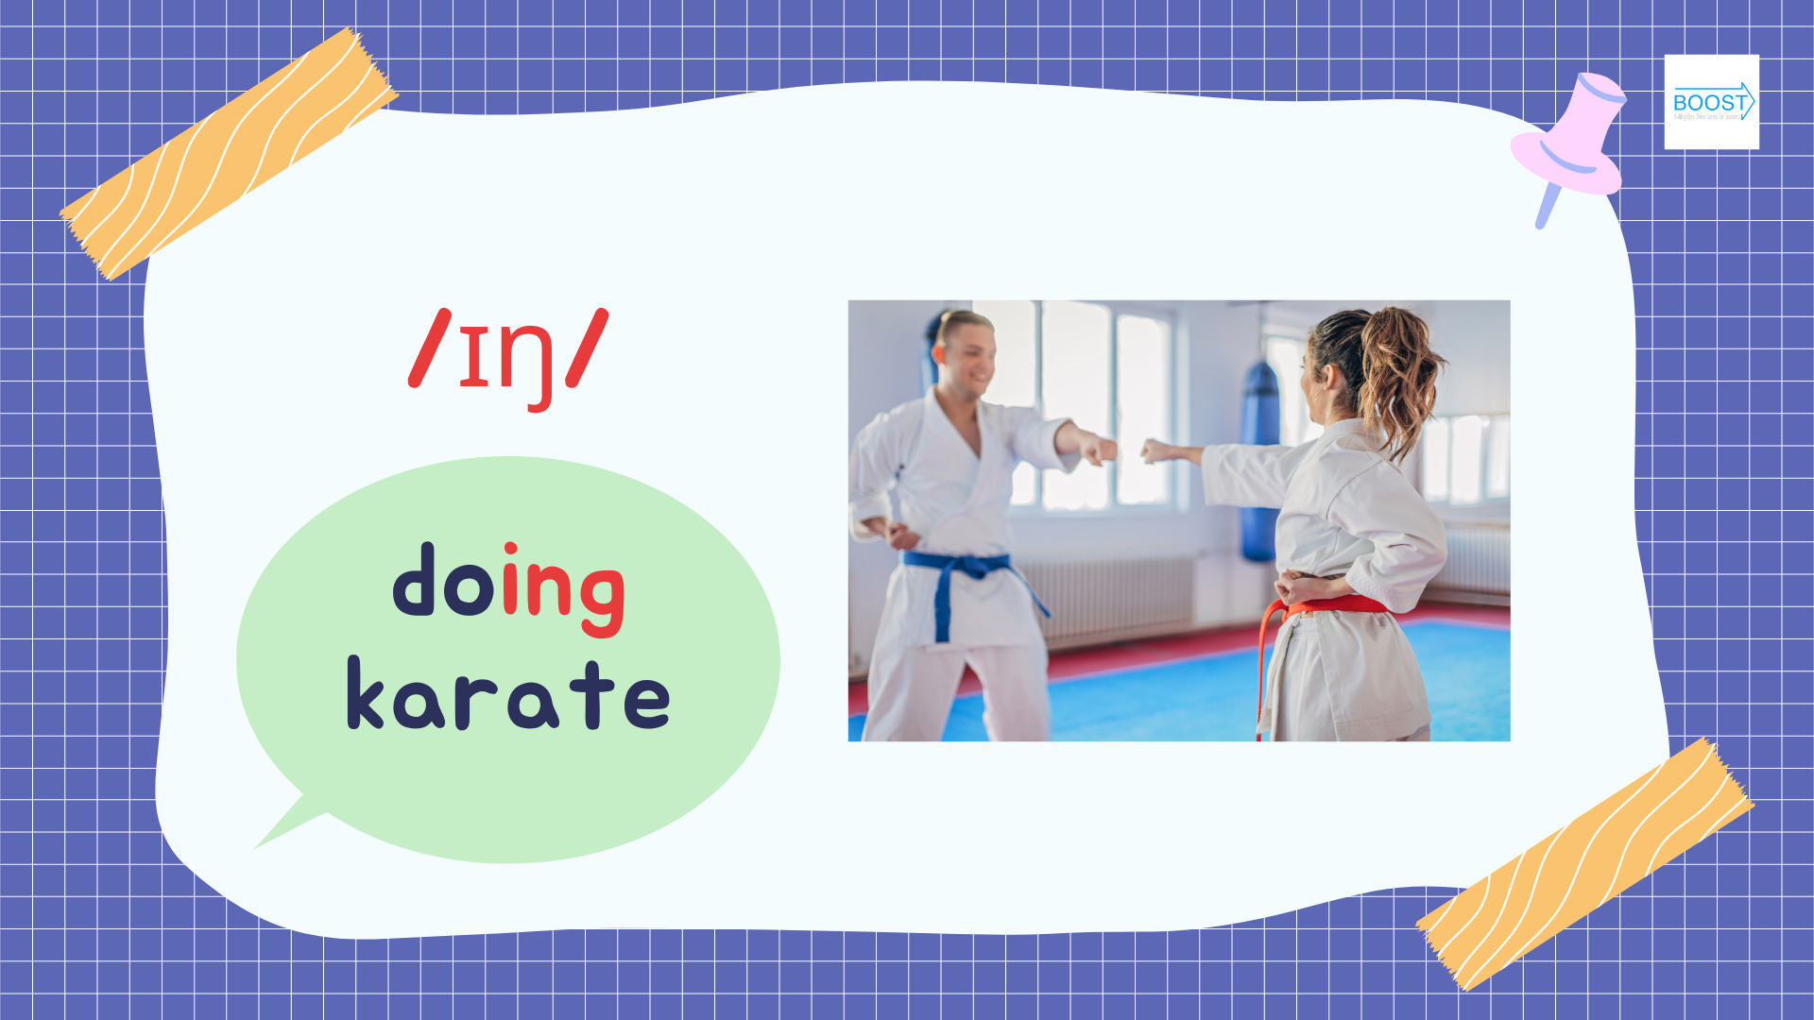
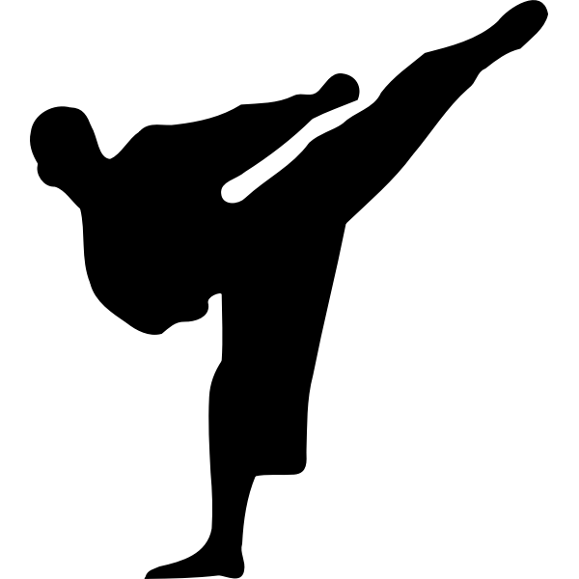
/ɪŋ/
doing karate
Notes:
/ɪŋ/
/ɪŋ/
Doing karate
Doing karate
He’s doing karate
He’s doing karate

